Slide 1
Vegan Restaurant Venture
IBM Data Science Certification Capstone Project

Slide 2
Introduction
According to research, people go vegan for many different reasons including but not limited to health, weight management, animal welfare, environment, concerns over antibiotics, and taste.
Additionally, livestock systems cover 45% of the Earth’s total surface. Agriculture accounts for 90% of US water consumption, more than 80% of farmland is used for livestock, animals raised for meat and dairy only account for 18% of calories and 37% of protein consumption.
However, here is a scenario if everyone went vegan what would happen. 129,544 fewer deaths annually in the UK, 0 cases of cancer connected to eating, the number would drop to 540 million hectares, and 70% decrease in food-related CO2 emissions.

Slide 3
Introduction
Clearly, it is worth exploring whether a vegan restaurant venture will be profitable.
In this project, I evaluate the potential of three different cities – Philadelphia, New York, and Boston – for the purpose of opening a vegan restaurant venture.
I utilize Foursquare, extract restaurant data, categorize that data, and determine which market is most suitable for such a business.
To do so, I use restaurant likes as a proxy for business success and performance.
I build linear and logistic regressions to evaluate the strength of the model and make the best-informed and wisest business decision based on the generated results.

Slide 4
Data
I take advantage of the Foursquare API to get information on restaurants' 'name', 'categories', 'latitude', 'longitude', and 'id' for each city.
I have decided to focus only on restaurants that are within 1,000 km of the three major cities I explore.
Since the data also results in non-restaurant venues, I manually clean the data and leave only restaurant information needed.

Slide 5
Methodology
I have used both linear and logistic regression to train and test the data.
Linear regression is most appropriate for predicting the number of “likes” a new restaurant in the above mentioned cities will acquire, while logistic regression is most appropriate for classifying the method.
To classify by number of “likes”, I bin the data and then multinomial logistic regression to perform the analysis.
For both methods, I have used the Ski-Kit Learn package.

Slide 6
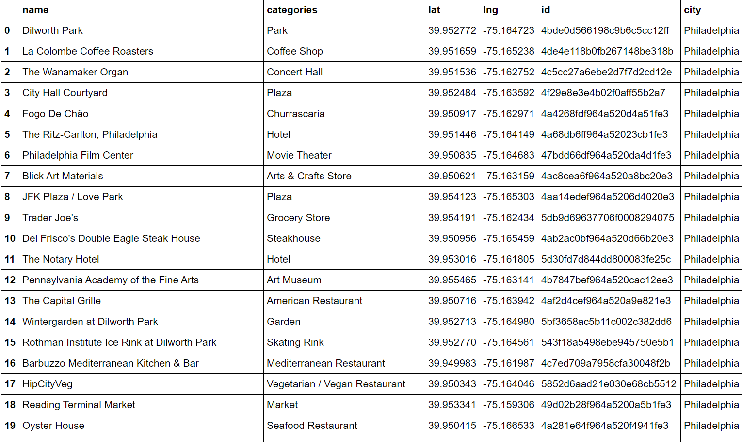
Initial Dataset

Slide 7
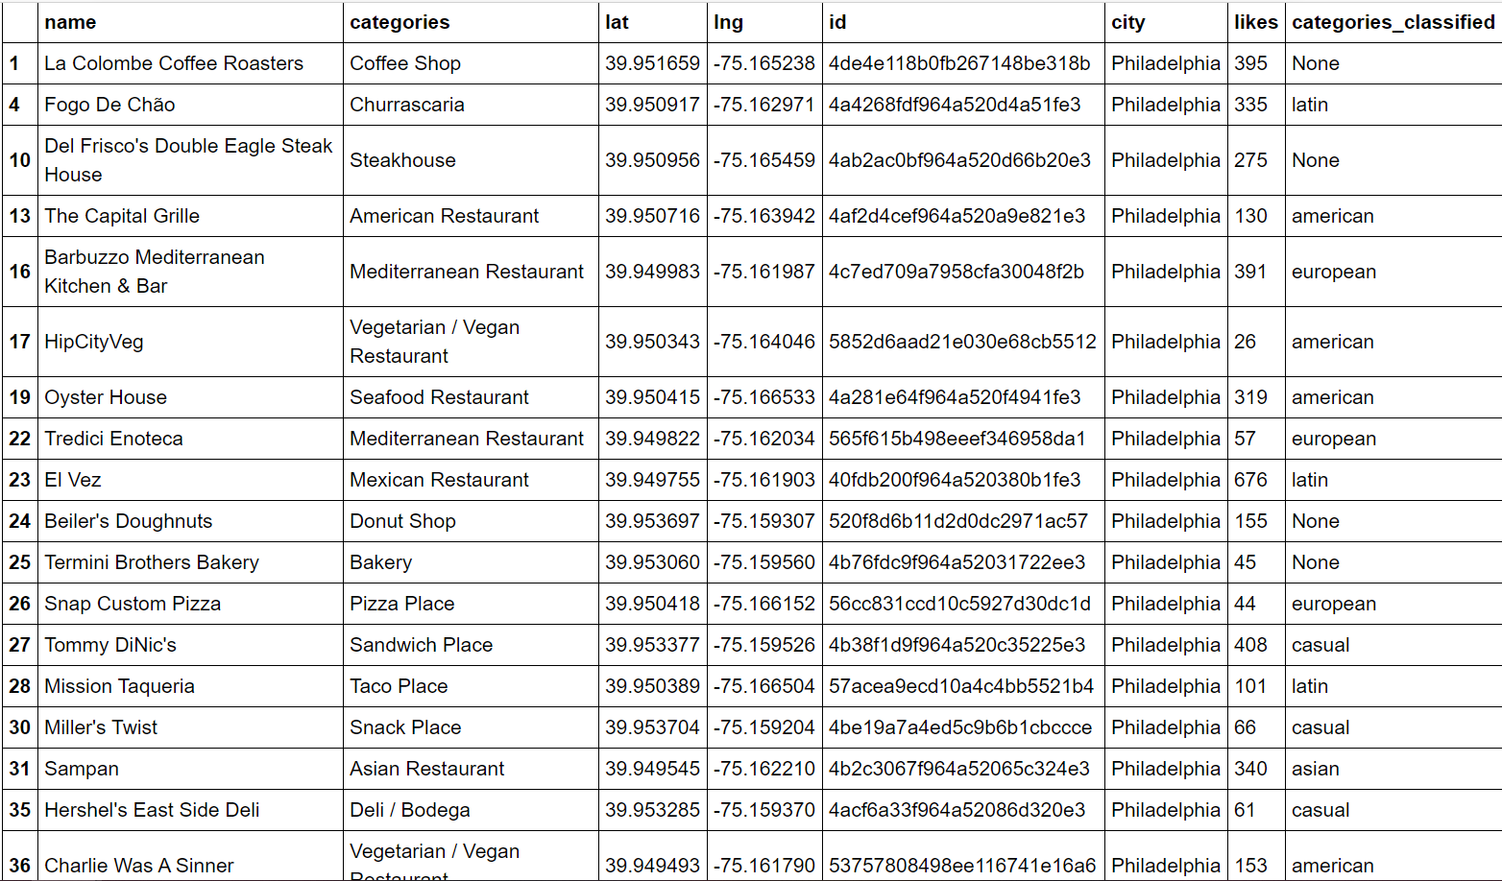
Clean Dataset

Slide 8
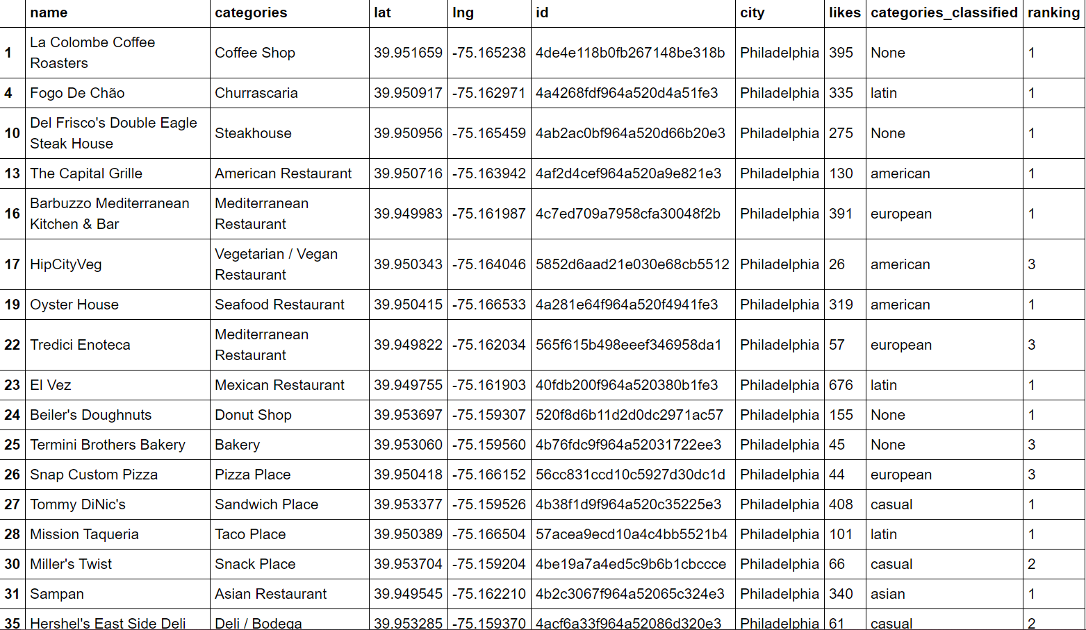
Final Dataset

Slide 9
Results
The first step has been to test a linear regression model on a random subsample of 80% and use the other 20% for testing purposes. To evaluate if the model is reasonable, I look at both the sum of squares and the variance calculated as 43503.22 and -0.04. The variance is negative which indicates that is not the best manner in which we can monitor the data.
The logistic regression model is trained on the same subsample and then is tested on the remaining 20%. The Jaccard score and log loss are 36.61% and 0.9494. The Jaccard score is at a reasonable enough level.

Slide 10
Results
I further run the model on the complete dataset. The coefficients I get show that opening a restaurant that is Asian, casual, European, Latin, and located in Boston is negatively associated with likes. Therefore, I conclude that an American restaurant serving vegan food options and located in either Philadelphia or New York will generate the highest performance.

Slide 11
Discussion
In addition to predicting the performance of the restaurant, I have also attempted to get insights on the business strategy to be used. The coefficients generated suggest that the business to be opened is an American restaurant serving vegan options.

Slide 12
Conclusion
In conclusion, after analyzing 300 restaurants in some of the biggest cities in the U.S. – Philadelphia, New York, and Boston – I find that the best approach to maximize performance is to open a restaurant with American vegan cuisine in either Philadelphia or New York. Given the rise in vegan options and the awakening of people, I believe that a vegan restaurant will be a profitable venture if executed with precision.

Slide 13


